Slide 1


Impact of Key Factors on CSK Team Success
in India’s Cricket Sport League - IPL
PRESENTED BY
Sai Ashok Madugula
Tanisha Kishan
Dheeraj Kumar Kusuma
Shamsheer Hussain Syed
Mechanical and Industrial Engineering Department
IE 6200: Engineering Probability and Statistics
Prof. Rehab Ali
Sec 05- Spring 2025

Slide 2
AGENDA
1
INTRODUCTION
2
PROBLEM STATEMENT
3
DATASET
4
DATA VISUALIZATION
5
STATISTICAL ANALYSIS
6
KEY RESULTS
7
LIMITATIONS AND FUTURE SCOPE

Slide 3
INTRODUCTION

Slide 4

CRICKET
From Backyard to Big Leagues: Cricket is played in many formats—from timeless Tests to thrilling T20s. Whether it’s international battles, domestic rivalries, or the high-octane IPL, the spirit of the game starts young and echoes across every level.
1 vs 11 – Bat, Bowl, Win: Cricket is played between two teams of 11 players each. One team bats to score runs while the other bowls and fields to restrict them. The team with the most runs wins!
International
Domestic
Leagues
India's Obsession: In India, cricket is more than a sport—it's an emotion. With over 90% of sports fans following cricket, stadiums roar, streets pause, and households unite for every major match.
Global Fame: Played in over 100 countries, cricket has strongholds in nations like England, Australia, South Africa, Pakistan, and Bangladesh. It unites cultures through World Cups, Tests, and global rivalries.
Billions Watch Worldwide: Cricket matches draw over 2.5 billion global viewers, making it the second most-watched sport after football. The 2023 ODI World Cup alone saw record-breaking digital and TV viewership.
Cricket in the Olympics (2028): Cricket is set to return to the Olympics in 2028 (Los Angeles), boosting its global appeal and reach.
IPL – Revolutionizing the Game: The IPL transformed cricket with player auctions, global icons, franchise drama, and strategic depth. It introduced cheerleaders, music, and matchday glam—bringing cricket to entertainment’s center stage.
Test
50 Overs
T20
IPL

Slide 5


Slide 6
PROBLEM STATEMENT AND PROJECT GOALS

Slide 7









PROBLEM STATEMENT
What key factors drive a team’s success or failure in the IPL Cricket across multiple seasons?
Despite the unpredictability of T20 cricket, are there measurable patterns behind consistent success? This project explores CSK IPL match data from 2020–2024 to uncover performance trends across batting, bowling, toss decisions, venues, and game phases—helping decode what truly drives wins in the IPL.

Slide 8
PROJECT GOALS
Understand CSK's performance trends from 2020–2024: Explore match outcomes, scoring patterns, and seasonal changes using available data.
Evaluate key match factors: Study the impact of toss results, batting/bowling performance, and venue influence on match outcomes.
Play with statistics and ask the right questions: Use descriptive and inferential methods to explore data, experiment, and uncover meaningful patterns.
Analyze venue-based performance: Identify how CSK performs across different stadiums to guide location-specific strategies.
Extract actionable insights: Turn data findings into clear strategies to improve decision-making in future matches.

Slide 9
DATASET

Slide 10
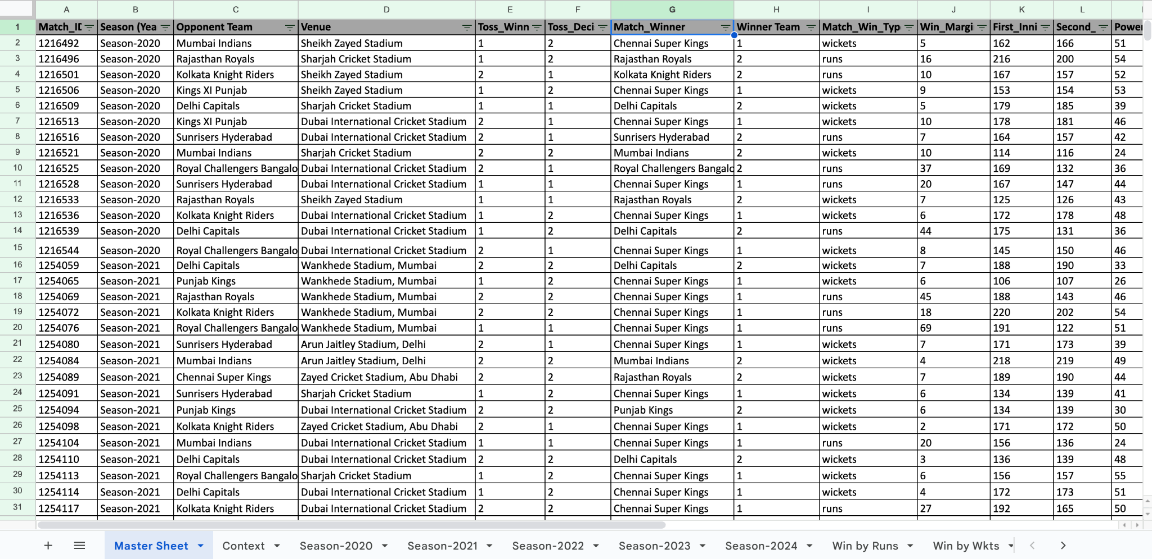
DATA COLLECTION AND PREPARATION
Extracting data from Kaggle Website to Excel
Comparing and Validating with Howstat and Official IPL Website
Data Cleaning and Adding misses
Categorical Segmentation of Data
Consolidation of data across various sheets

Slide 11
DATA VISUALIZATION

Slide 12
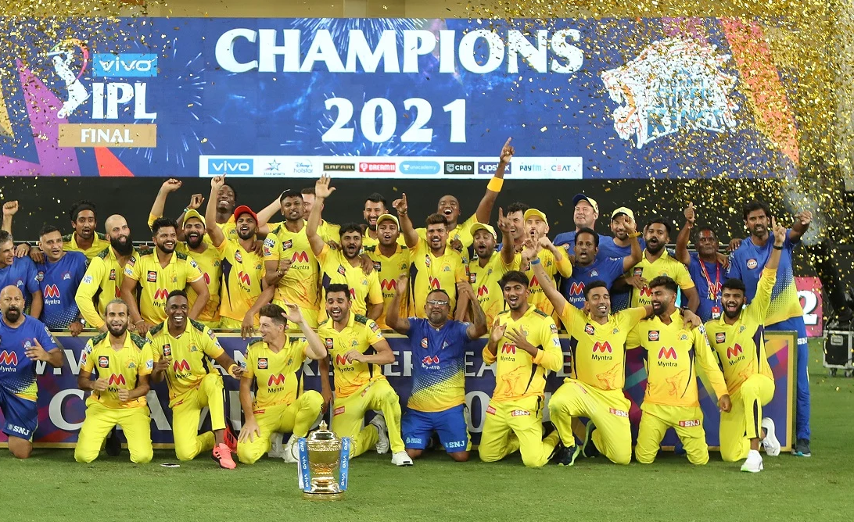
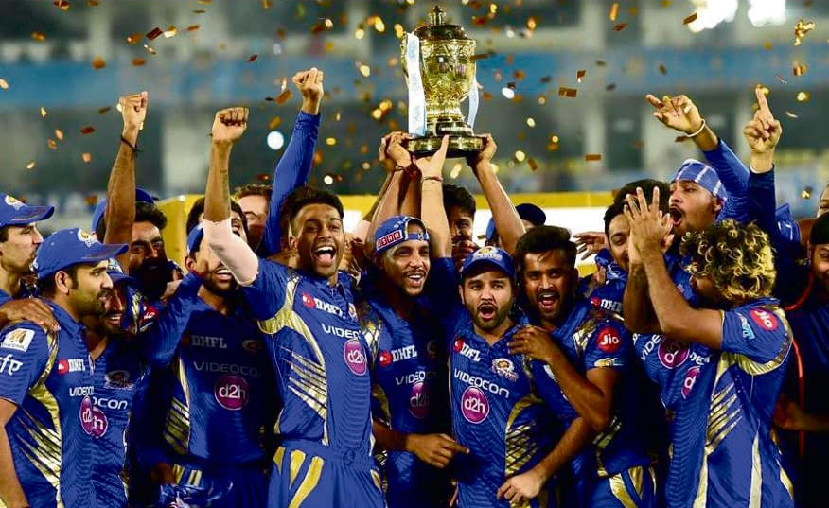
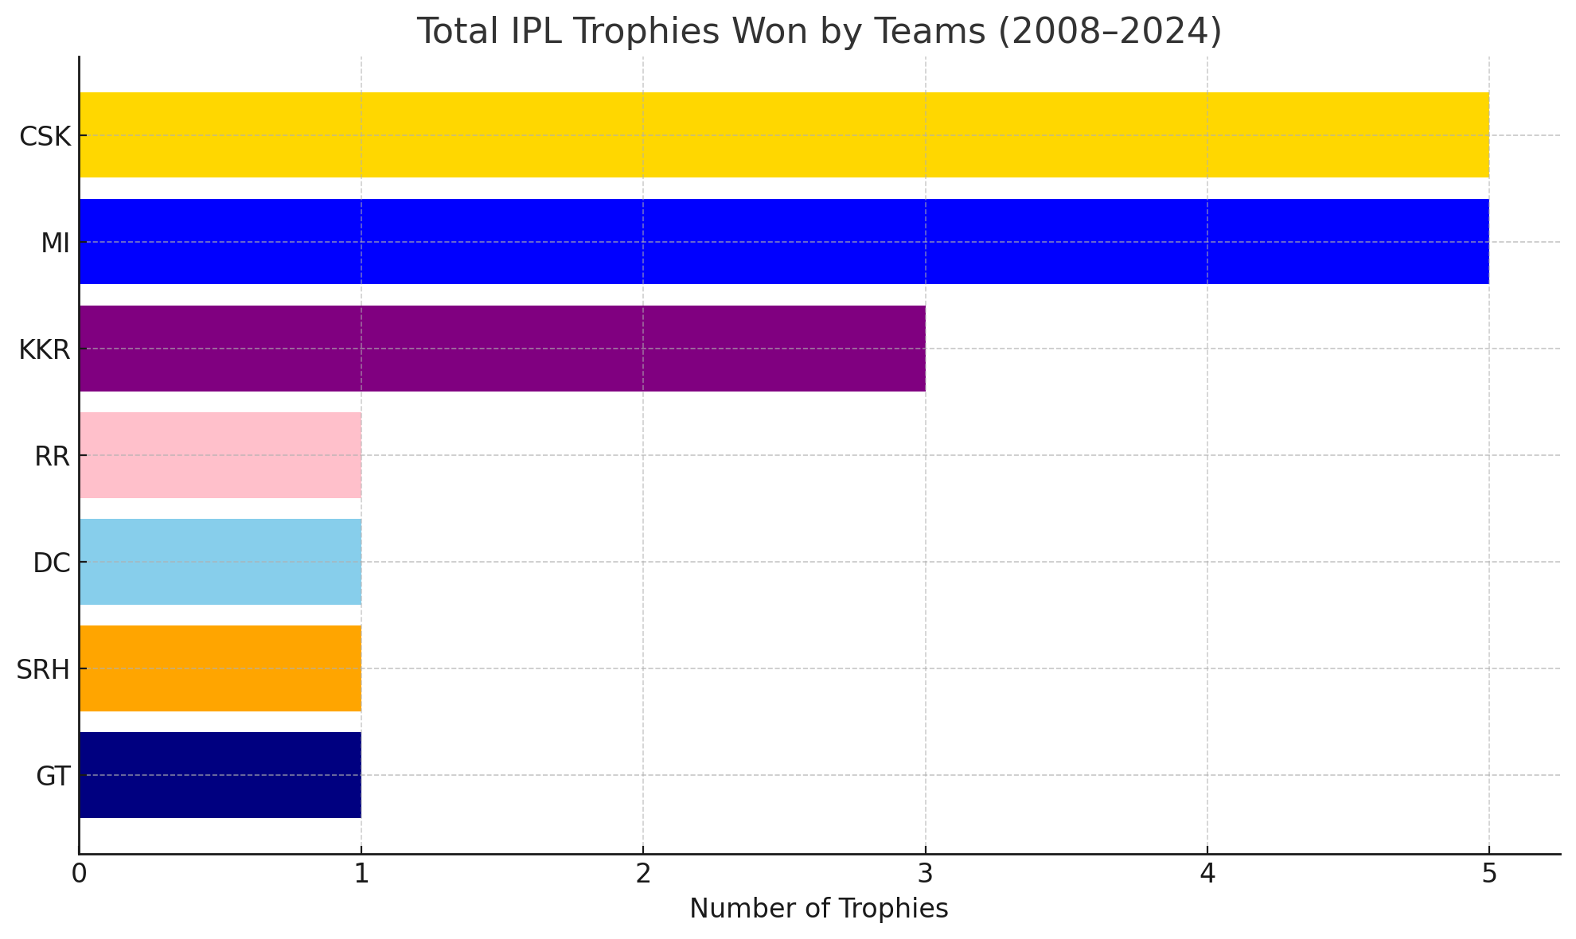


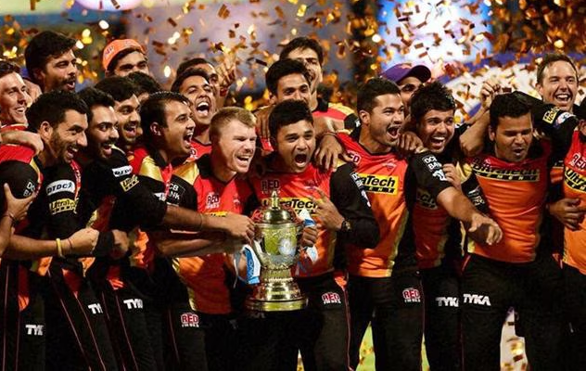

Horizontal Bar Chart - IPL Performance Landscape

Slide 13

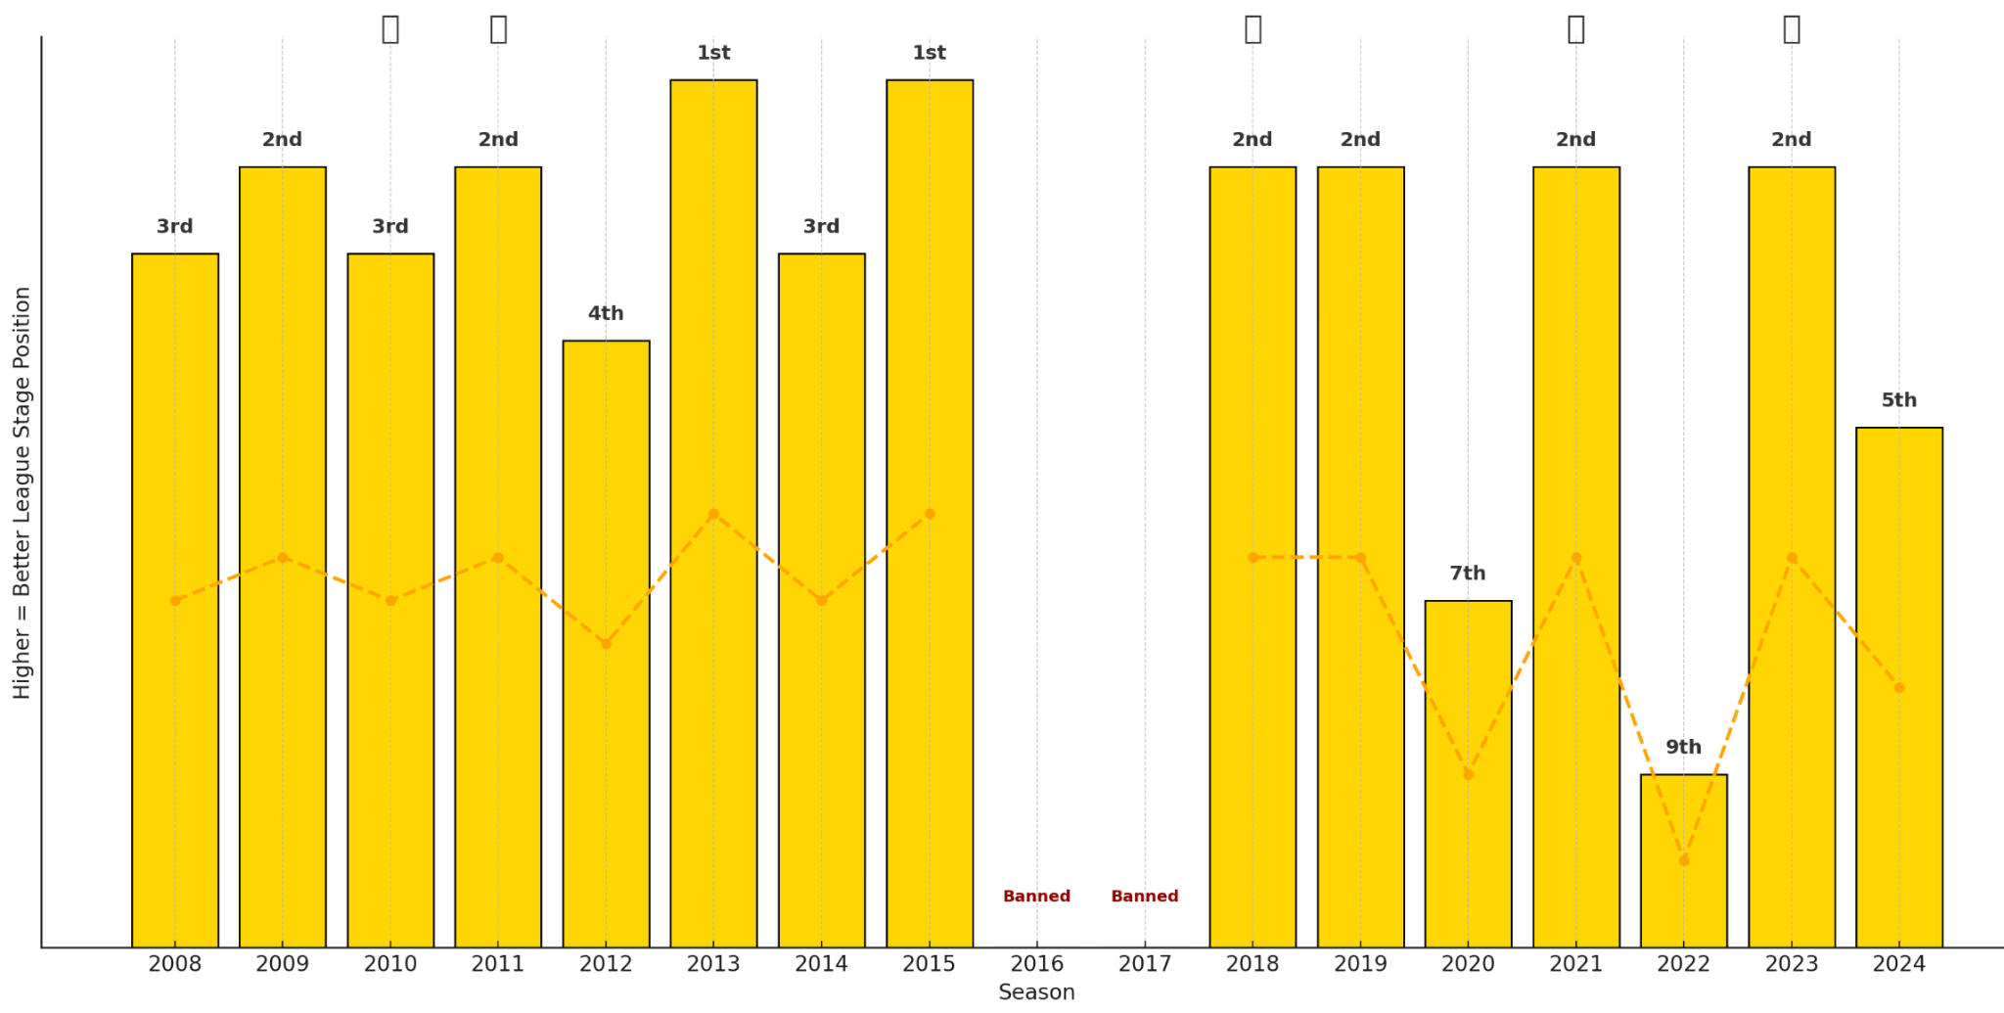
Bar Chart - CSK’s Journey (2008–2024):
5-Time Champions
10-Time Finalists
12-Time Qualifier
58% Win Rate
4-Time Table Top
Seen Ups & Downs
Captain Dhoni Legacy

Slide 14
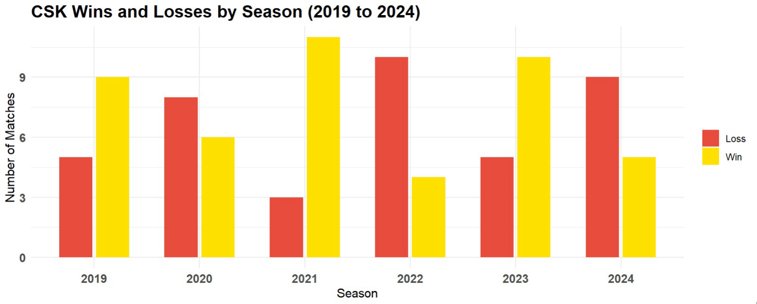
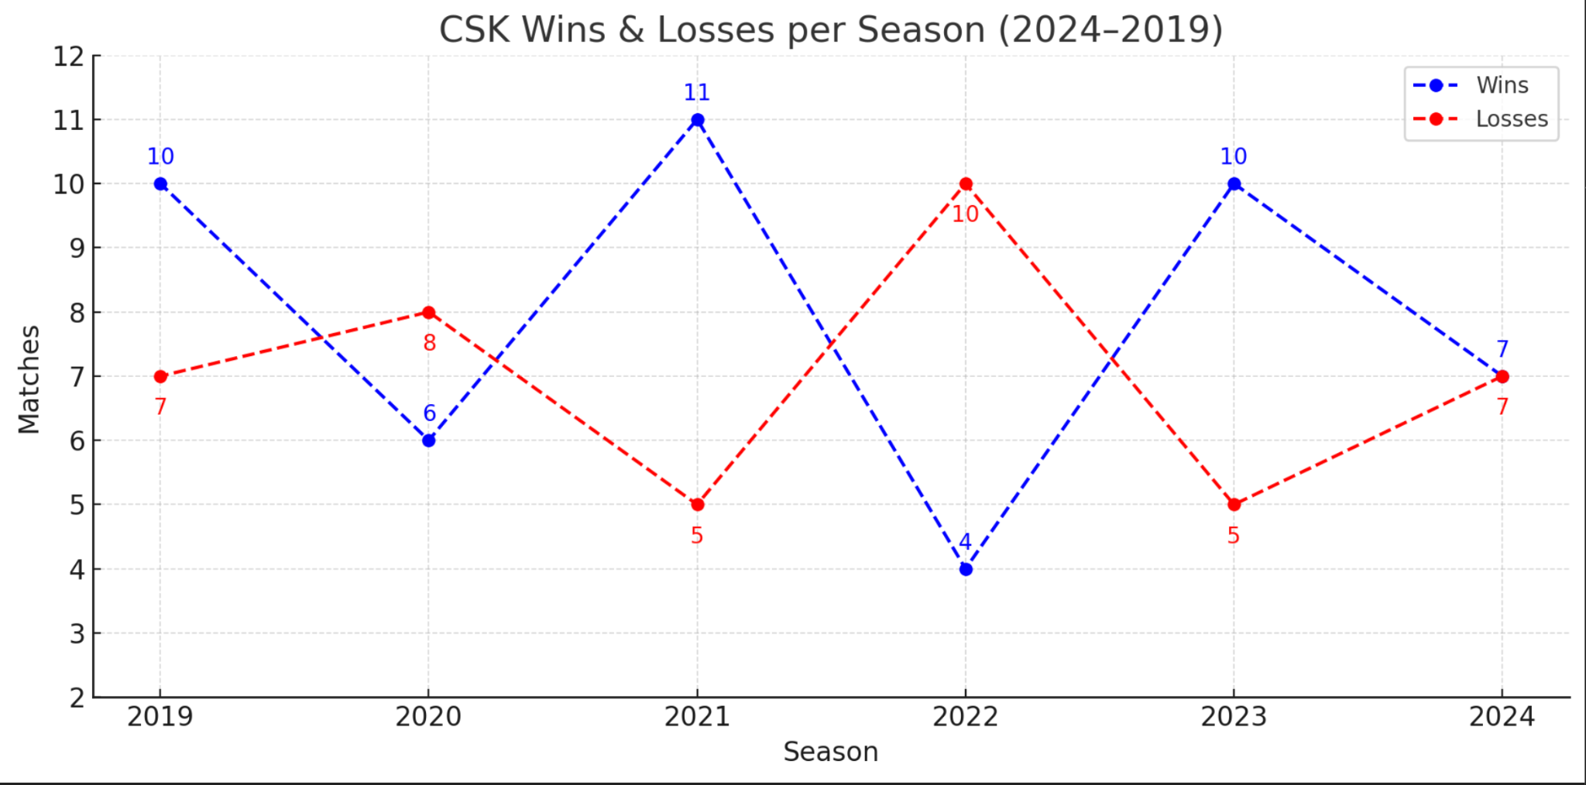
Grouped Bar Chart - CSK Performance
Dotted Line Chart - CSK Performance
Win-Loss Contrast: Clear visual comparison each season
Win-Loss Gaps: Distance between lines shows performance margin
Dominance Indicator: Taller yellow bars reflect strong seasons
Performance Trends: Easy to spot rising/falling form
Seasonal Balance: Quickly spot seasons with near-equal outcomes
Sharp Variations: Highlights drastic swings between seasons

Slide 15
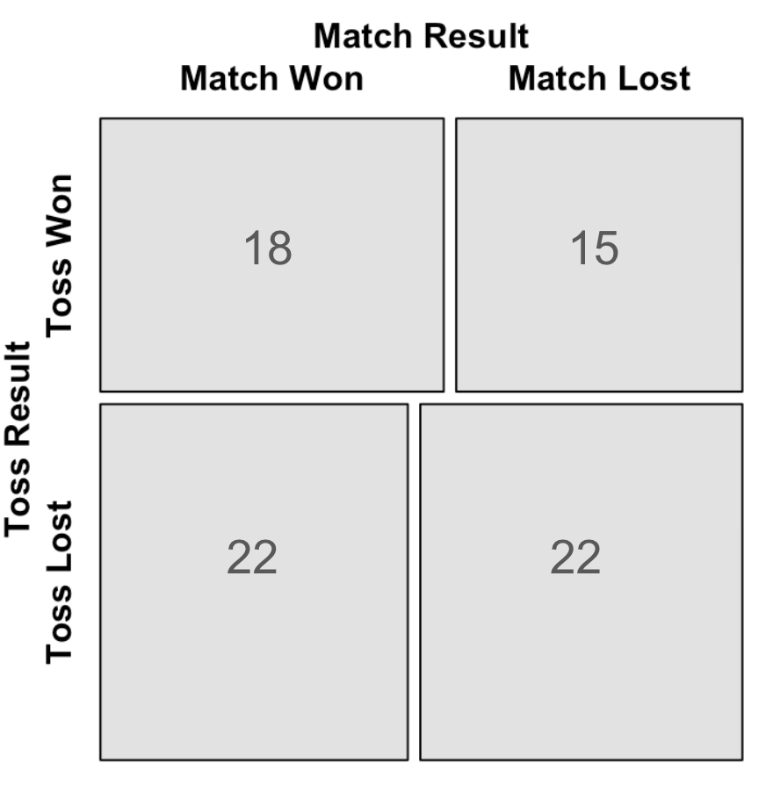
Mosaic Plot - CSK Toss vs Match Outcome:
Does winning the toss influence CSK’s match outcomes, or is their performance independent of toss results?
No Toss Advantage: Winning the toss didn’t guarantee a match win (18 wins vs 15 losses)
Stronger After Toss Loss: CSK won more matches (22) after losing the toss than when they won it (18).
Balanced When Toss Lost: Equal number of wins and losses (22 each) when toss was lost
Psychological Edge? Possibly better under pressure or chasing unplanned situations
Strategic Independence: Team performance doesn’t rely heavily on toss outcome
This graph shows how toss outcomes relate to match results, revealing hidden performance patterns.

Slide 16
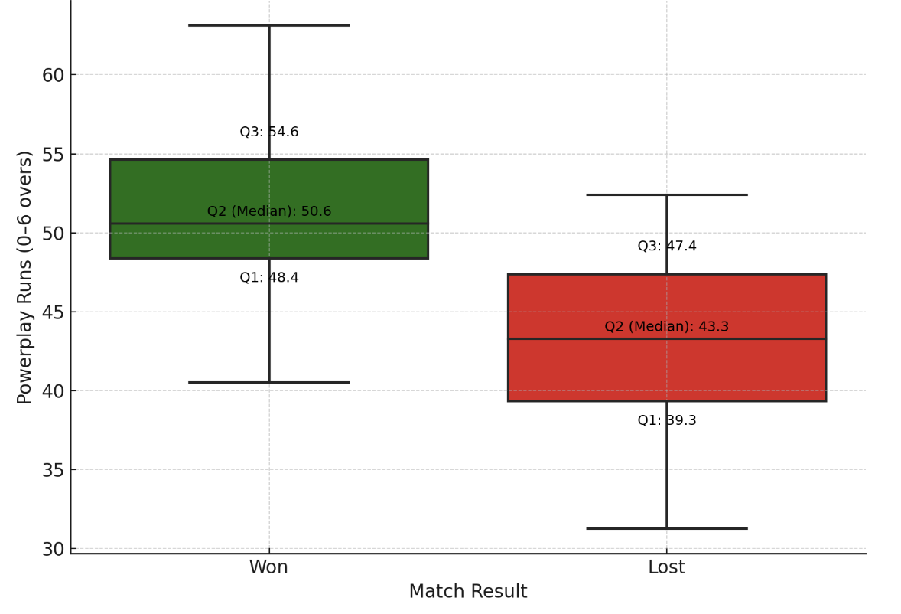
Box Plot - Powerplay Scores (Wins vs Losses)
Do higher and more consistent Powerplay scores increase CSK’s chances of winning matches?
Higher Median in Wins: Matches won have a median powerplay score of 50.6, compared to 43.3 in losses.
More Consistent in Wins: The interquartile range (IQR) is narrower in wins, suggesting steadier starts.
Lower Bound in Losses: Q1 for losses drops to 39.3, indicating slow starts often lead to defeats.
Upper Potential is Key: Winning games show a higher Q3 of 54.6, showing aggressive starts contribute.
Visual Impact: The color contrast clearly differentiates match outcomes by powerplay performance.
This box plot shows how higher powerplay scores are linked to winning more matches.

Slide 17
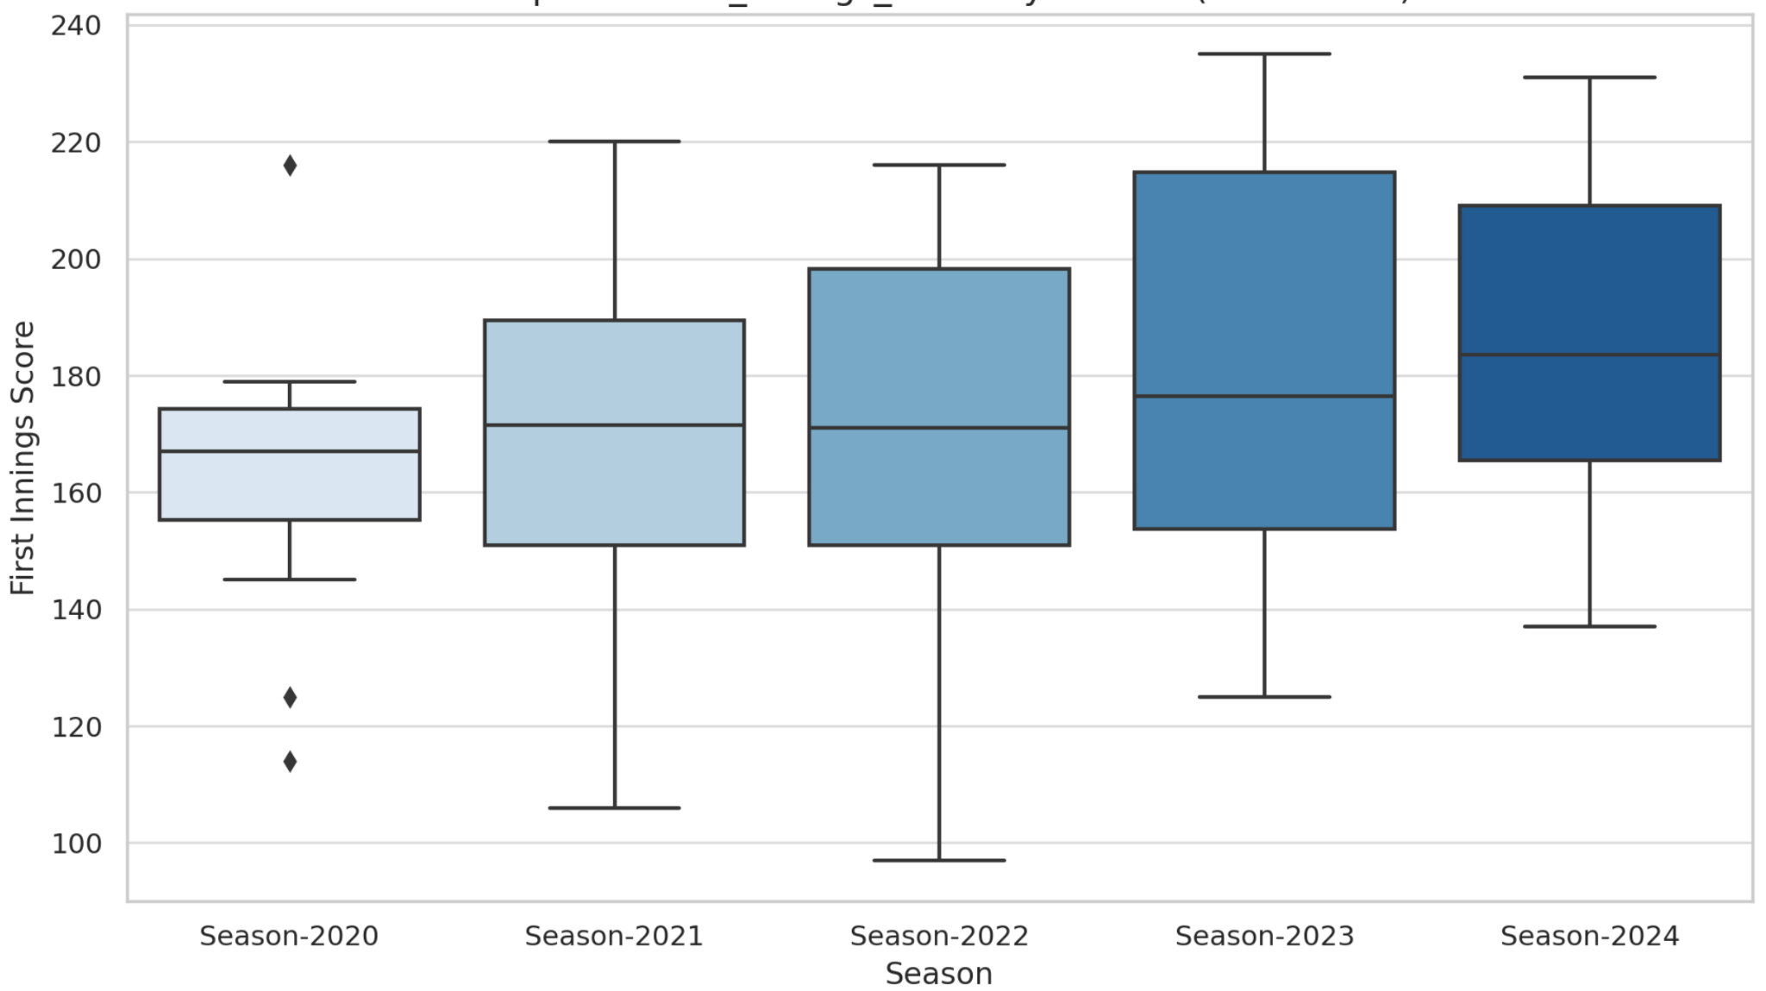
Box Plot - First Innings Scores (2020–2024)
How have CSK’s first innings scores evolved over the last five seasons, and what does the variability reveal about their performance trends?
Upward Trend: Median scores rise steadily from 2020 to 2024, indicating more aggressive starts.
2023 Highest Spread: Season-2023 has the widest range (low to high), showing high scoring volatility.
2020 Most Consistent: Season-2020 has the tightest IQR, reflecting stable first innings scores.
Outliers in 2020: Two low outliers show a couple of very poor starts that season.
Improved Baseline: The lower bounds have shifted upward since 2020, reflecting better minimum performances.
This box plot shows a steady rise in first innings scores from 2020 to 2024, with 2023 having the highest scoring variability and 2020 being the most consistent season.

Slide 18
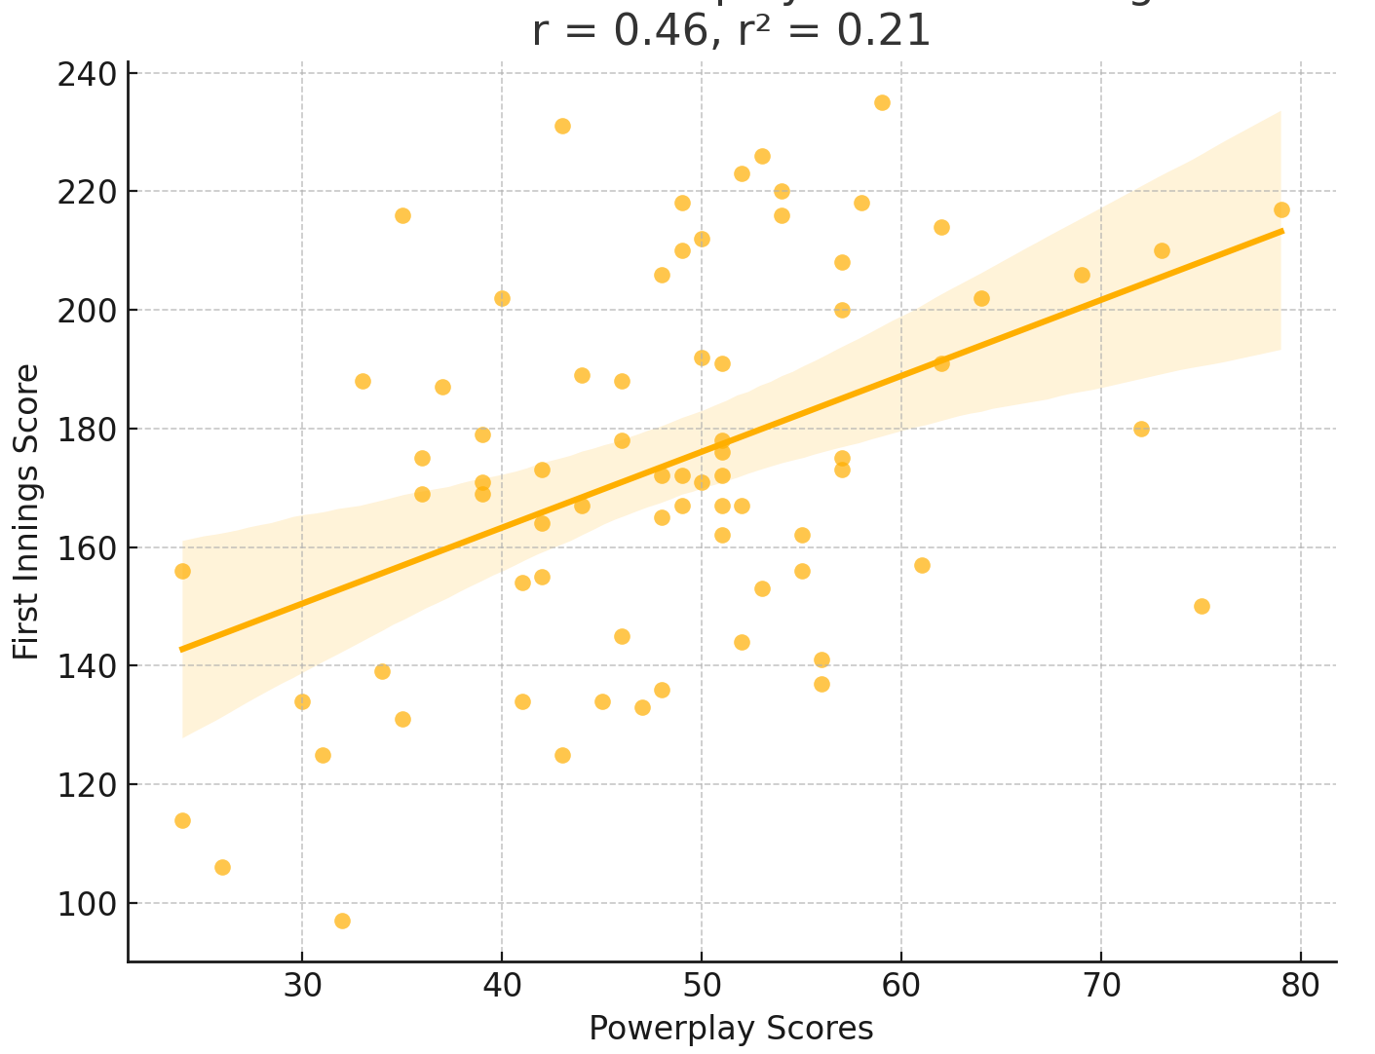
Scatter Plot – Powerplay vs First Innings Scores
Does a strong Powerplay performance lead to higher first innings scores for CSK?
Positive Correlation: As powerplay scores increase, first innings totals tend to rise (r = 0.46)
Moderate Strength: With r² = 0.21, about 21% of the variation in total score is explained by powerplay performance.
Spread of Data: While the trend is upward, there’s significant variability, showing not all high starts guarantee big totals.
Strategic Insight: Improving power play scoring could meaningfully impact overall innings outcomes.
Predictive Value: The regression line and shaded area show a predictive trend for estimating first innings scores from powerplay runs.
This scatter plot shows a moderate positive correlation (r = 0.46) between powerplay scores and first innings totals, suggesting that strong starts generally lead to higher team scores.

Slide 19
STATISTICAL ANALYSIS

Slide 20
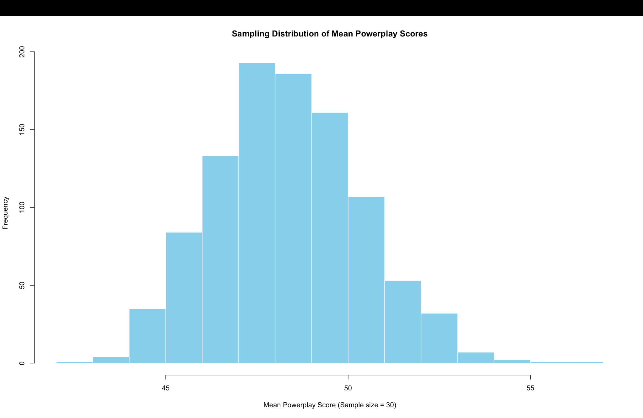
Sampling Distribution of Means – Powerplay Scores
Is CSK’s Powerplay performance consistent, and does it follow a normal distribution suitable for strategic planning?
Simulated 1000 random samples (n=30) of CSK’s Powerplay scores to examine the distribution of sample means. This was done to validate the Central Limit Theorem and assess CSK’s Powerplay consistency.
Normal Shape: Distribution is bell-shaped, confirming Central Limit Theorem
Stable Mean: Most sample means fall between 46 and 50, centered at ~48.
Low Variability: Narrow spread implies consistent Powerplay performance.
Few Outliers: Minimal extreme values suggest reliable starts by CSK.
Strategic Insight: Indicates a predictable scoring pattern in the first 6 overs, useful for planning.
This histogram shows the sampling distribution of CSK’s mean Powerplay scores, forming a normal curve centered around 48, aligning with the Central Limit Theorem.

Slide 21
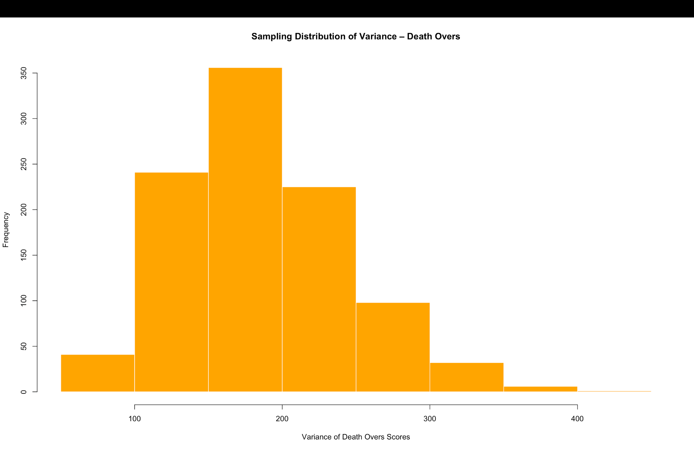
Sampling Distribution of Variance – Death Over Scores
How consistent are CSK’s performances in the death overs, and what patterns of variability emerge under pressure?
Simulated 1000 random samples (n=30) of CSK’s death-over scores to study the variability in finishing phases, aiming to assess consistency and detect patterns of volatility under different match conditions.
Right-Skewed Shape: Indicates presence of some very high-variance finishing performances.
Peak at 175–200: Most common variance level, showing moderate but frequent fluctuations.
Long Tail: A few matches have high volatility, possibly due to big finishes or collapse.
Inconsistent Closes: Wider spread than powerplay scores, signaling less predictability.
Situational Influence: Variability likely depends on match context, bowling attack, or pressure.
This histogram displays a right-skewed distribution of CSK’s death-over score variance, highlighting occasional explosive or inconsistent finishes.

Slide 22
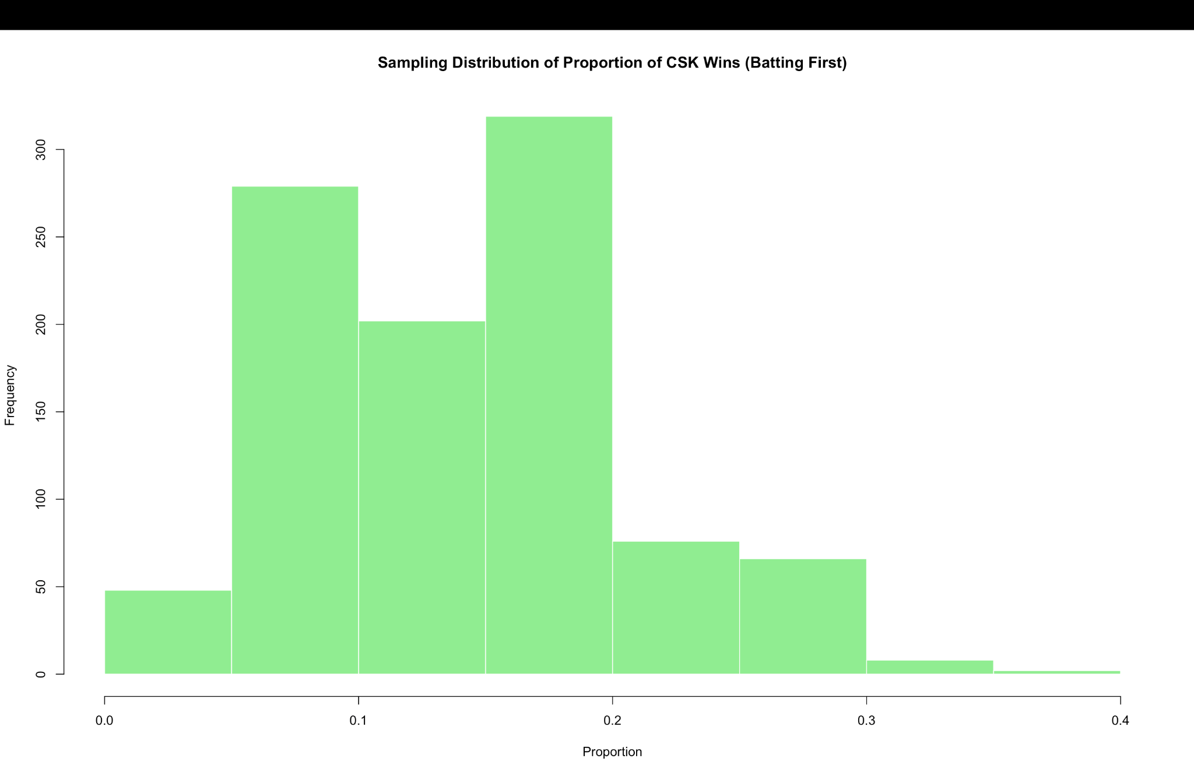
Sampling Distribution of Proportion – CSK Wins When Batting First
Analyzed 1000 random samples (n = 30) of CSK matches where they batted first to study their win proportion and identify if they perform better chasing or setting a target. This helps inform strategy decisions like toss preferences.
How often does CSK win when batting first, and what does it reveal about their target-setting ability?
Right-Skewed Curve: Most values lie between 10%–25%, showing limited dominance when batting first.
Chasing Advantage: Low win proportion suggests stronger chasing performance historically.
Target Setting Struggles: Few high-proportion wins imply inconsistency in defending scores.
Sample Spread: Wide spread with outliers shows occasional high success but not a regular pattern.
Tactical Implication: Supports decision to field first when winning the toss, especially on high-scoring grounds.
This histogram shows that CSK wins a lower proportion of matches when batting first, with most values clustered below 25%, and a slight right skew indicating occasional strong defenses.

Slide 23
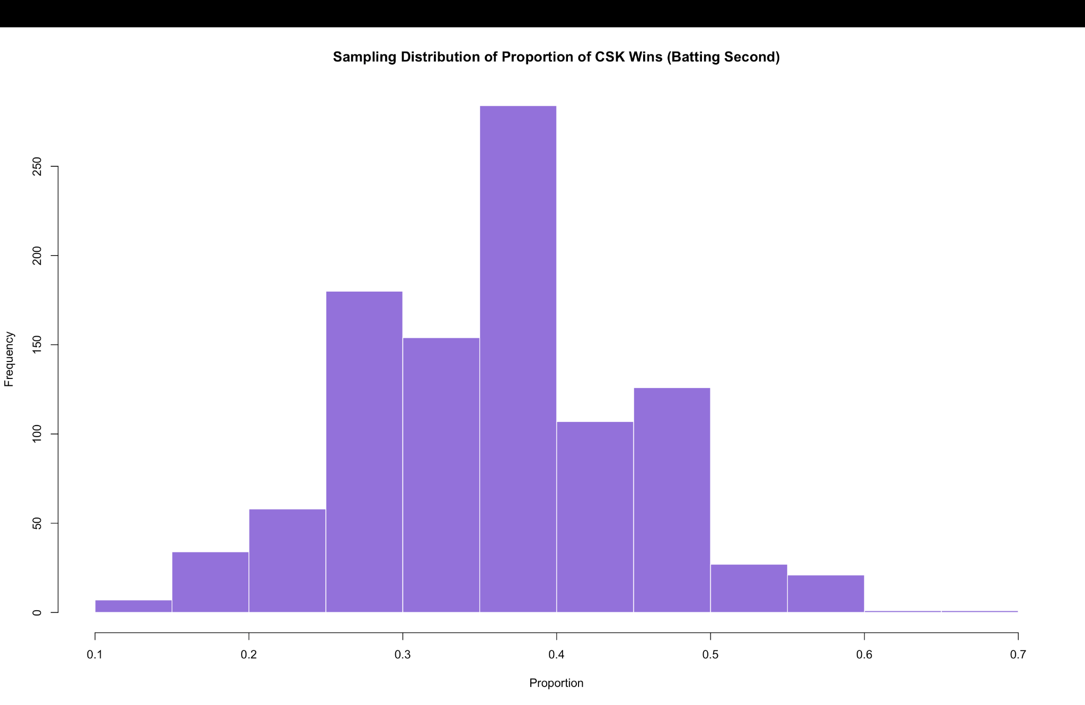
Sampling Distribution of Proportion – CSK Wins When Batting Second
Simulated 1000 random samples (n = 30) of CSK matches batting second to evaluate how consistently they win while chasing. This helps assess whether chasing offers a strategic advantage.
Does CSK perform more consistently when chasing, and does this suggest a strategic advantage?
Peak at 0.35–0.40: Most common win proportion lies in this range, suggesting strong chasing performance.
Right-Skewed Shape: Implies occasional high-win proportions, indicating brilliant run chases.
Better than Batting First: Distribution sits higher than the batting-first graph, reinforcing a strategic edge.
Tactical Insight: Supports the decision to field first after winning the toss, especially on good batting tracks.
Consistency in Chases: Compact mid-range clustering reflects reliable performance under pressure, often led by star finishers.
This histogram displays the sampling distribution of CSK’s win proportion while chasing, with most values clustering between 0.35 and 0.40—indicating a strong preference for chasing.

Slide 24
What is CSK’s expected first innings score at different IPL venues, and how can it guide venue-specific strategy?
Used a 1-sample t-confidence interval to analyze CSK’s first innings scores at major IPL venues. With 95% confidence, the average score lies between:
• 160–190 at MA Chidambaram (Chennai) – consistent home scoring
• 139–189 at Wankhede (Mumbai) – variable performance
• 177–238 at Modi Stadium (Ahmedabad) – high scoring potential
These intervals support data-driven, venue-specific strategies.
Confidence Interval of Mean
Does CSK’s first innings score significantly differ between matches they win and lose?
Used a two-sample t-confidence interval to compare first innings scores.
The mean score in wins was 171.2, and in losses 165.8.
The 95% confidence interval for the difference was [-16.3, 27.0], with a p-value of 0.610.
Since the interval includes 0 and p > 0.05, there is no significant difference, suggesting first innings score alone doesn't determine the match outcome.
Confidence Interval
Confidence Interval of Difference of Mean
What proportion of matches does CSK win after winning the toss?
Used a 1-sample z-confidence interval to estimate CSK’s win proportion after winning the toss.
Out of 33 games, CSK won 57.6% (19 games). The 95% confidence interval for the true proportion is [0.401, 0.733].
This suggests CSK’s win rate after winning the toss likely lies between 40.1% and 73.3%.
Confidence Interval for Proportions

Slide 25
Does CSK win significantly more than 50% of matches when batting first?
Null (H0): Win proportion ≤ 0.5
Alternative (H1): Win proportion > 0.5
p-value = 0.0272
Conclusion: There is significant evidence (p < 0.05) that CSK wins more than 50% of the time when batting first.
Batting First
Is CSK’s win percentage over 50% when batting second?
H0: The win percentage <= 0.5
H1: Win share greater than 0.5
0.0333 is the p-value.
Conclusion: CSK also wins by a margin of more than 50% when they bat second.
Hypothesis Testing
Batting Second
Is there a significant difference between CSK’s win rates when batting first vs. chasing?
Method: Two sample proportion Test for Win Proportions:
First-Bat: 66.67%
Second batsman: 63.63%
p-value is 0.795.
Conclusion: There is no statistically significant difference between batting first and second in terms of win percentage.
Comparison of Batting Strategies

Slide 26
KEY RESULTS

Slide 27
KEY RESULTS
Powerplay Scores: Bell-shaped distribution centered at 48. Targeting 46–52 runs improves win probability.
Death Overs: Right-skewed variance (175–200), showing explosive yet inconsistent finishes.
Batting Impact:
Batting First: Lower win rate (<25%), but significant when successful (p = 0.0272).
Batting Second: More consistent wins (35–40%), statistically significant (p = 0.0333).
Toss Outcome: 57.6% win rate after toss wins; not statistically significant (CI includes 0.5).
Score in the First Innings Not a Sole Factor: Wins and defeats did not significantly differ in first innings scores, indicating that other stages or match circumstances are more important.

Slide 28
LIMITATIONS AND FUTURE SCOPE

Slide 29
LIMITATIONS
Missing Player-Level Metrics: No inclusion of individual performance data like economy, strike rate, or dot ball percentage.
External Factors Ignored: Weather, pitch type, and match conditions not accounted for in the analysis.
Time frame Constraints: Analysis limited to 2020–2024; may overlook long-term or evolving trends.
Binary Outcome Focus: Only win/loss considered—margin of victory, match context, or pressure situations not analyzed.
Uniform Match Weighting: All matches treated equally, including high-pressure playoffs or finals.

Slide 30
NEXT STEPS
Expand Dataset Scope: Extend analysis beyond the last 5 seasons to include all IPL seasons for broader and long-term insights.
Team Benchmarking: Compare CSK’s patterns with teams like MI, GT, or RCB to uncover competitive advantages and gaps.
Add Player-Level Metrics: Include individual stats like top scorers, dot ball %, economy rates for deeper performance insights.
Phase-Wise Match Analysis: Use regression or machine learning to evaluate impact of each match segment (e.g., powerplay, middle, death overs).
Incorporate Contextual Factors: Integrate weather and pitch data to improve accuracy of strategy suggestions.
Run Simulations: Test scenarios like “chasing 180 at Eden” to model likely outcomes and decision impacts.

